Slide 1
INTRO TO HTML & FORMATTING, PT 2
CSCI 1210
Essentials of Web Design

Slide 2
HTML Elements
Defining document structure
HTML has many elements that are defined to create documents for the web

Slide 3
Why do we need different elements?
Written Language
Written text, in any language, includes rules and conventions for constructing documents so that they effectively present their content
In the English language, our documents can include articles, sections, asides, headings, lists, tables, images, and so on that are used to arrange the document's information in a logical fashion that conveys meaning to the reader
We can drill down further with paragraphs, each of which consists of one or more sentences

Slide 4
Why do we need different elements?
Document
[Heading]
Section/Article/ Aside
Paragraph/Image/List/Table Figure
Sentence

Slide 5
Inline Elements
Structural elements that don’t break the flow of the document.
Elements we can apply at the ‘sentence level’
These elements modify content within a sentence (or sentences) without breaking it/them up

Slide 6
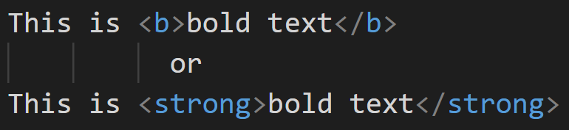
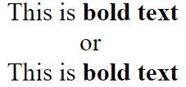
<b> / <strong>
Modifies text, making it appear bold

Slide 7
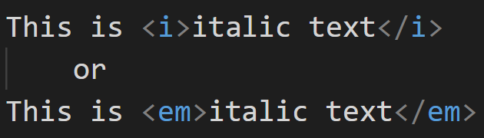
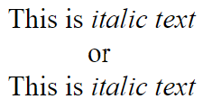
<i> / <em>
Modifies text, making it appear italic

Slide 8
Inline Elements
<label> <q> <script> <select> <span> <sub> <sup> <textarea>
<a> <abbr> <acronym> <button> <cite> <code> <img> <input> <kbd>

Slide 9
The Flow
When the document is rendered by a browser, it starts in the upper left corner and ‘flows’ across the display until it reaches its right edge
It then starts at the beginning of the next line, and so on, rendering the document line-by-line

Slide 10
Paragraph
<p>…</p>
Using HTML, other elements can be included inside the paragraph element, but it usually consists of text (and inline elements) only
They ‘break the flow’ of the document’s rendering, reset the cursor at the beginning of the next line, add whitespace, display, and add more whitespace

Slide 11
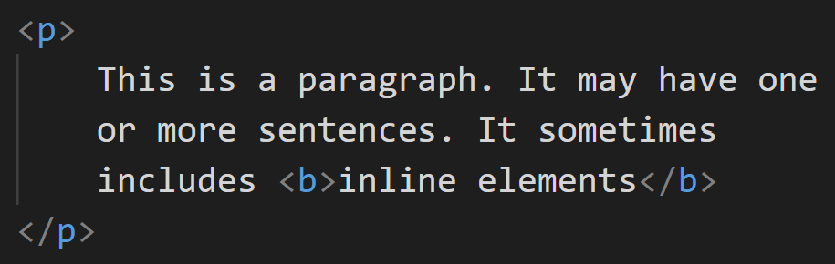
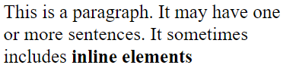
<p>

Slide 12






What is a computer?
DESKTOP PC
LAPTOP
PHONE
An electronic device that accepts data as input, processes it, stores it and gives out information as the output. [1]
GAMING CONSOLE
ROUTER
SMART HOME DEVICE
1. Components of a Computer System. University of Iowa.

Slide 13
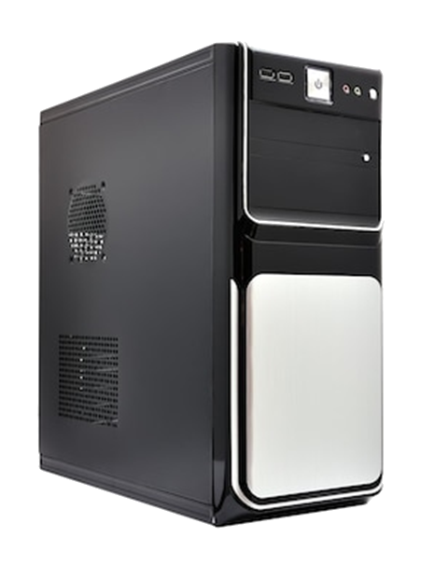
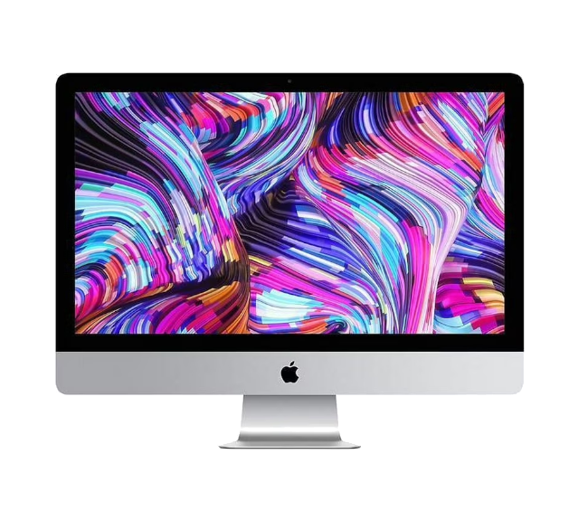
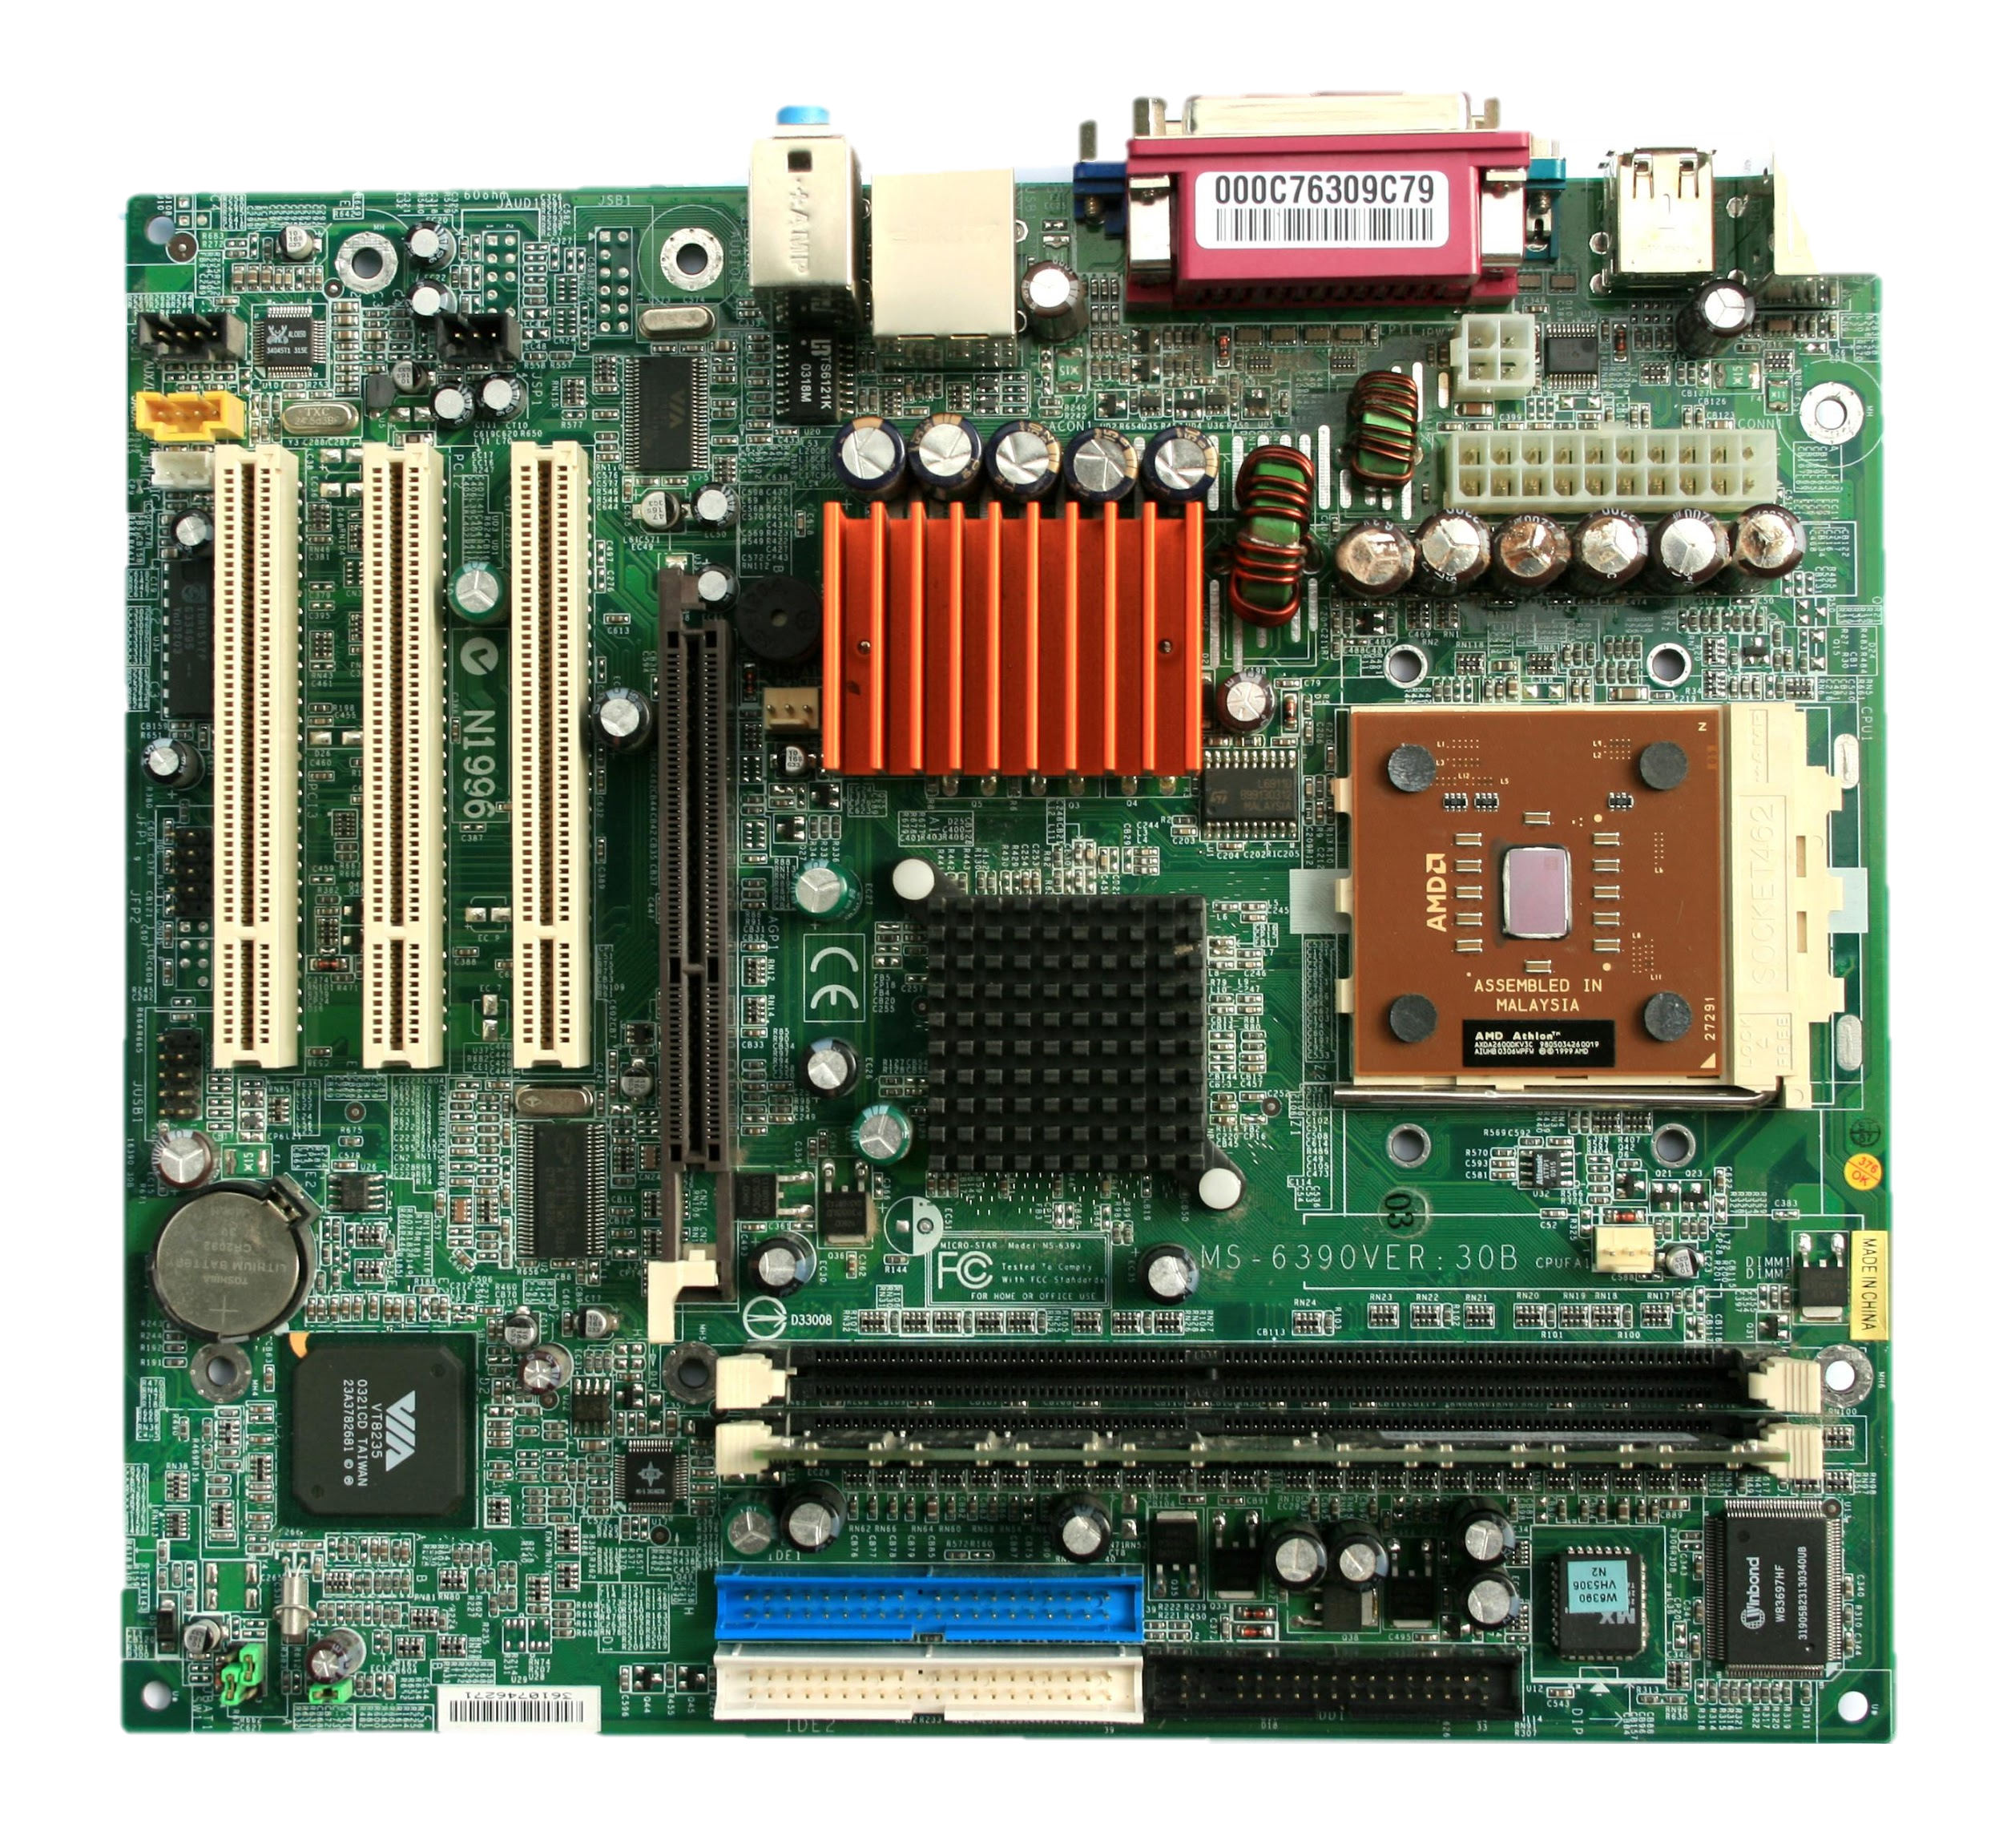
The Big Stuff
System Unit
The case housing all the digital electronic components that comprise a working computer. Not referring to the components themselves.
Left: A tower-style PC case. You would need to connect a display, such as a monitor, to use this one.
Right: All-in-one computers, like this iMac combine the system unit with the display. All the computer parts are housed behind the display.
Motherboard
The main circuit board to which all chipsets and memory devices connect.
Chipset
The electronics on the motherboard that manage the data flow between processors, memory, & peripherals.
This Photo by Unknown Author is licensed under CC BY-SA

Slide 14
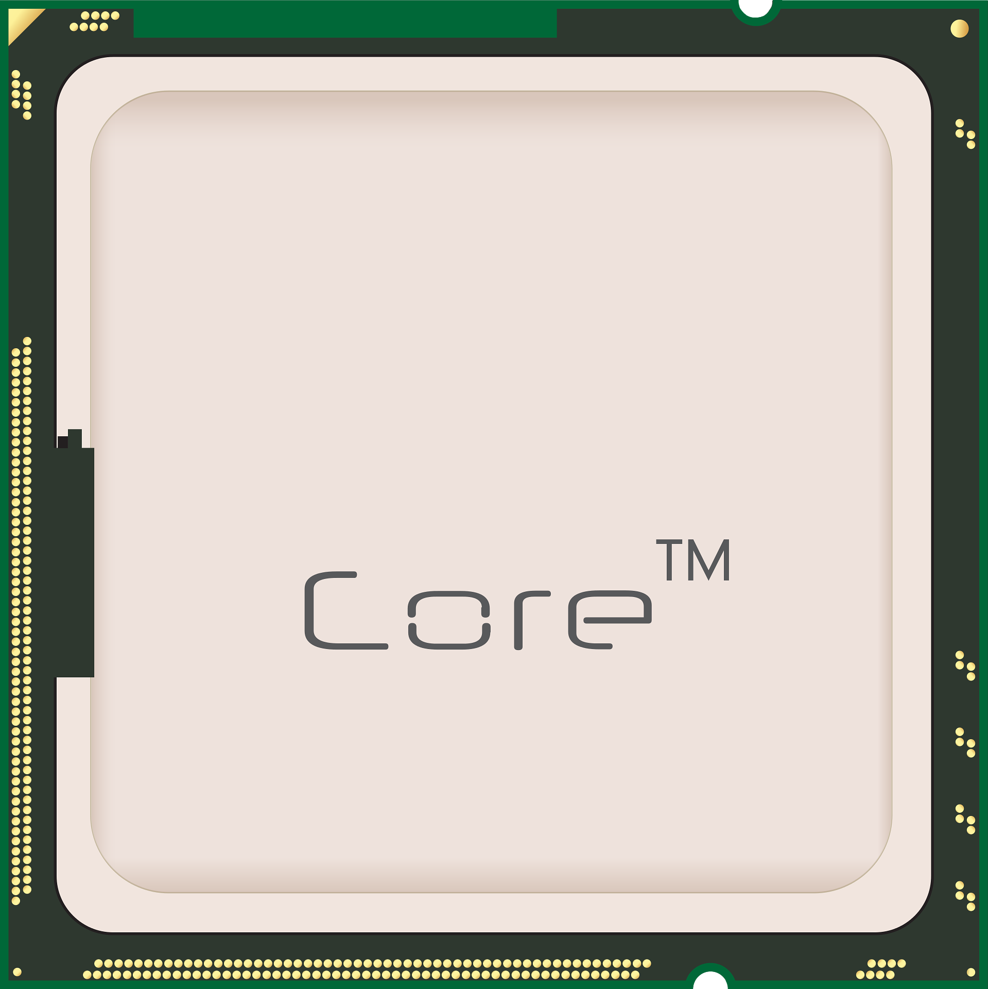
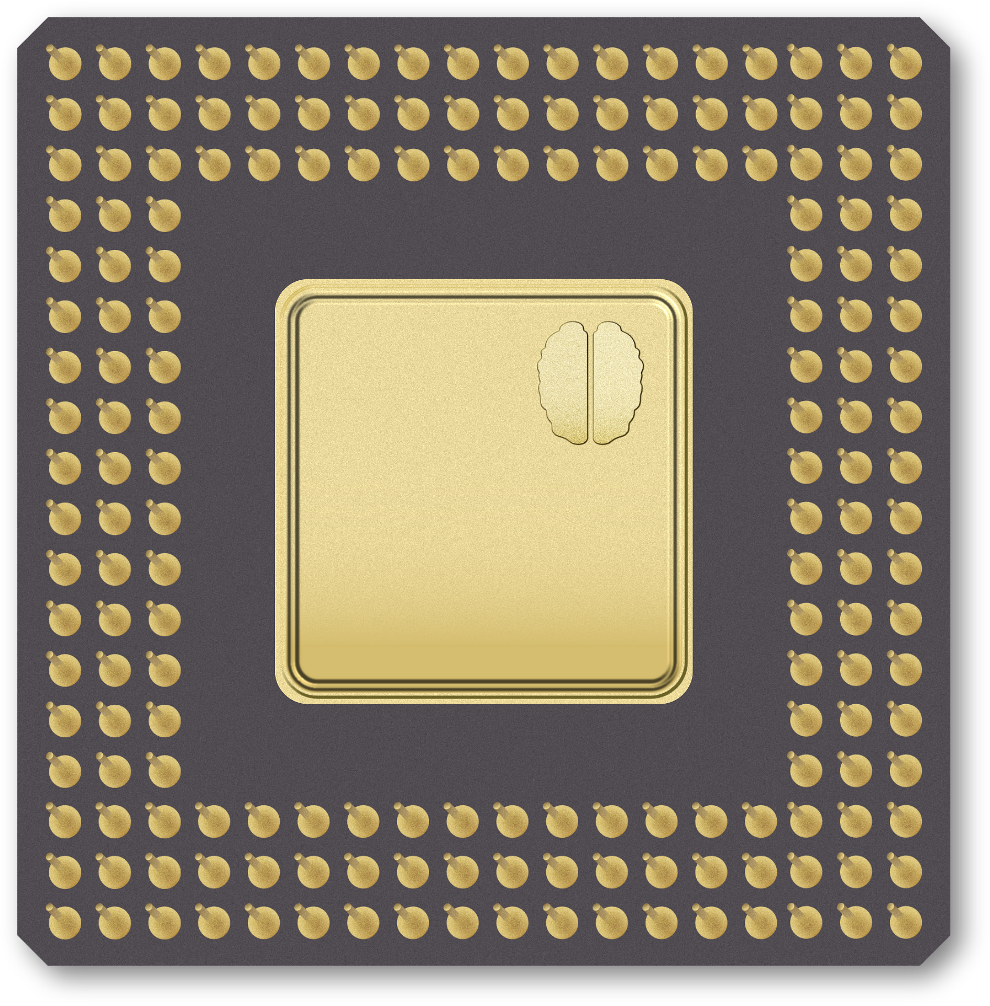
What is a CPU? (Central Processing Unit)
Top right:
CPU with pins on the back – called Pin grid array (PGA) – connect to metal plates called lands on the motherboard’s CPU slot.
Other CPUs have flat plates on the back – called land grid array (LGA) – for slots with pins.
Performs all basic operations.
“X.X GHz” = of operations per second.
The “Brain” of a computer.
Can have 1+ cores.
More cores = more operations at a time.
Newer generation ➔ significantly better performance, power efficiency, newer tech.

Slide 15
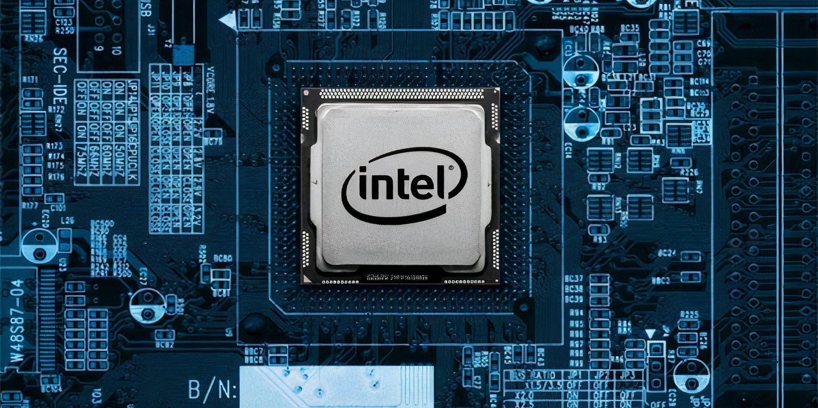

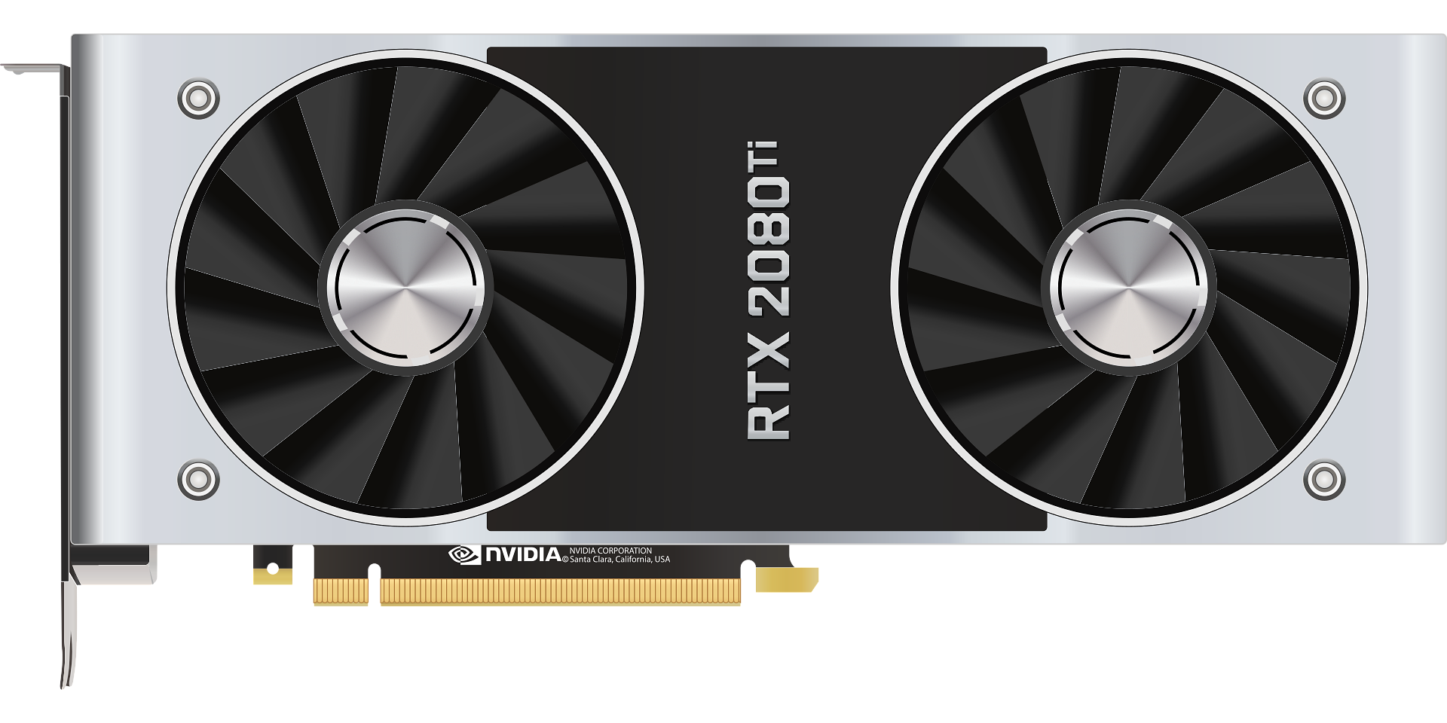

What is a GPU? (Graphics Processing Unit)
Integrated Graphics:
Bundled with the CPU. More economic.
Handles displaying things to the screen.
Dedicated Graphics Card:
Sold or installed separately. More powerful.
3D models, video games, and video editing take more power.

Slide 16
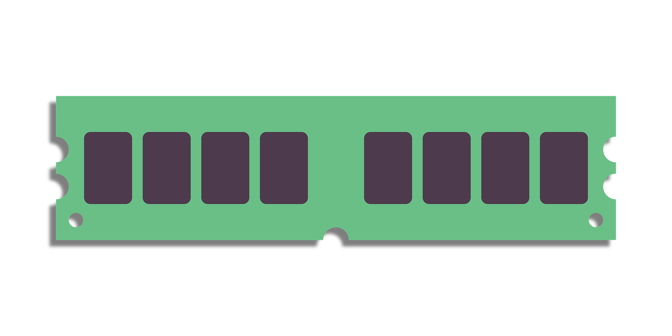



Where is my stuff? Part 1: RAM (Random Access Memory)
Storage for programs (Google Chrome, Siri, Call of Duty)
Short Term – only stores current program data.
More RAM allows for more multitasking.

Slide 17
Where is my stuff? Part 2: How Memory Is Measured
8 bits make a byte – the most basic unit of measurement in computing
A Petabyte (PB) is 1000 TB
A Terabyte (TB) is 1000 GB
A Gigabyte (GB) is 1000 MB
A Megabyte (MB) is 1000 KB
A Kilobyte (KB) is 1000 bytes
PB
TB
GB
1000x the level below
MB
KB
B
Notes:
1 byte ~= 1 single character of text
3 bytes ~= 1 pixel in an image
That’s over 6.2 million bytes for a single uncompressed HD image.
1 megabyte = 1 million bytes
1 gigabyte = 1 billion bytes
1 terabyte = 1 trillion bytes
1 petabyte = 1 quadrillion bytes (That’s 15 zeros!)

Slide 18

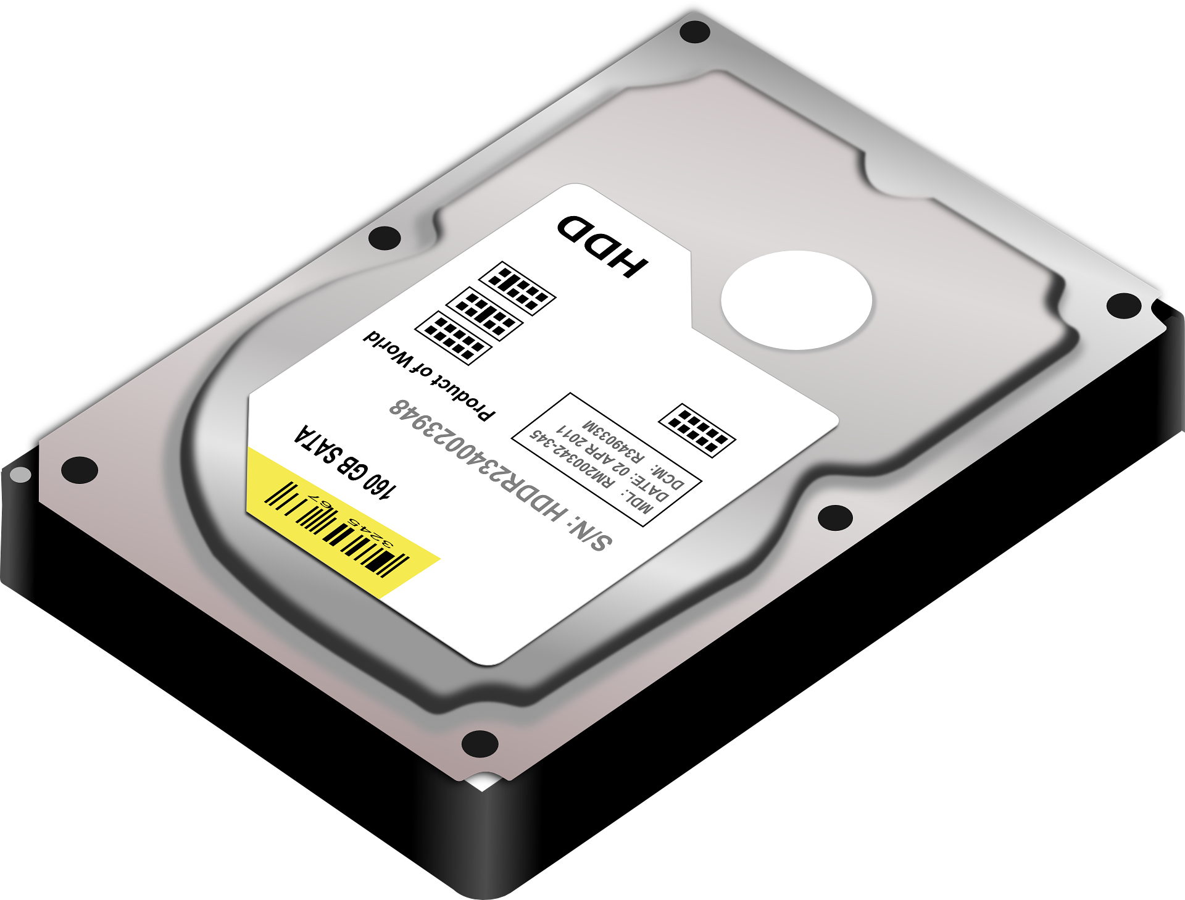

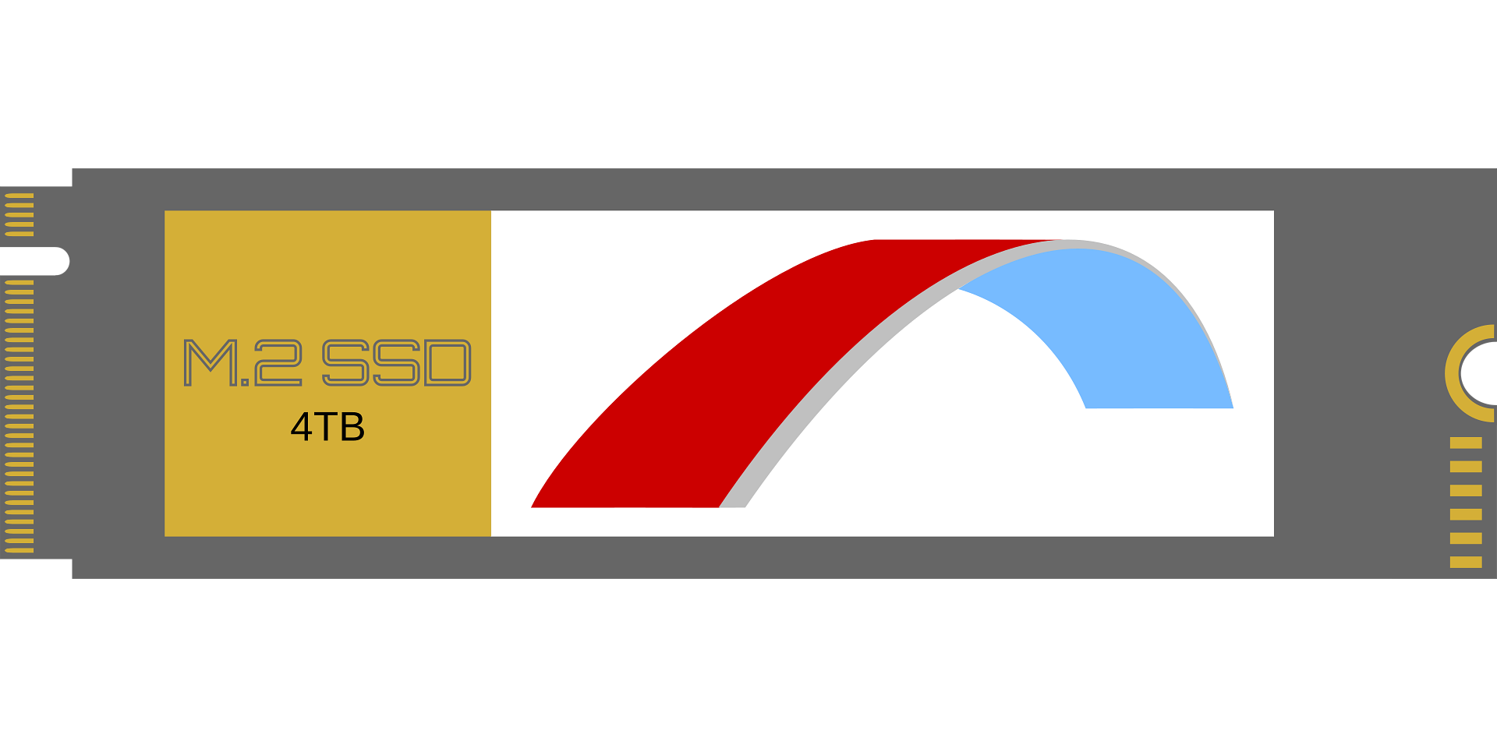

Where is my stuff? Part 3: The Hard Drive
Long term storage (Word files, programs, cat pictures) of different sizes (128GB…500GB…2TB…8TB)
Hard Disk Drive (HDD) – Cost-efficient storage, slower.
Solid State Drive (SSD) – Faster, less space, more expensive.

Slide 19
The Hard Drive: SSD vs HDD
SSD | HDD
faster ✅ | ❌ slower
more expensive ❌ | ✅ cheaper
non-mechanical (flash) shock-resistant ✅ | mechanical (moving ❌ parts wear out)
best for storing operating systems, gaming apps, & frequently used files | best for storing extra data, such as movies, photos, & documents
VS
Some PCs and less portable laptops use both! SSD stores the operating system (MacOS, Win 11), HDD for additional bulk storage.
An OS installed on an SSD loads much faster than it would on a HDD.
Spinning mechanical parts are slower than electrons!

Slide 20
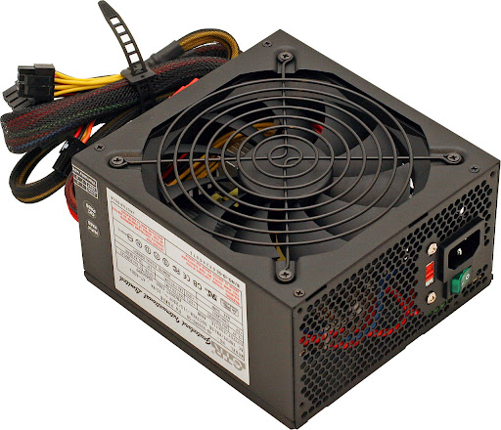
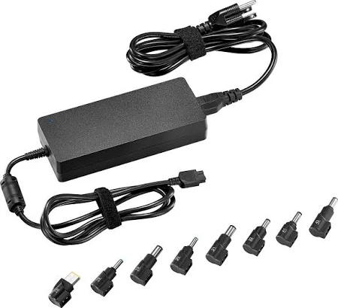
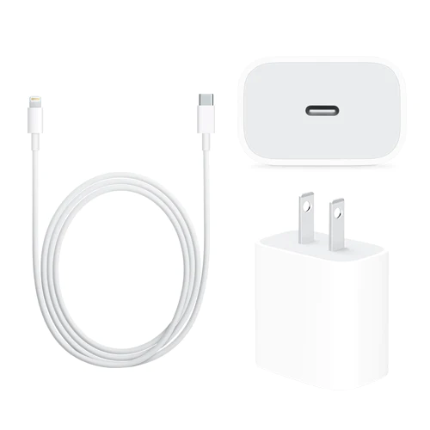

The Power Supply
Converts AC power from the wall into DC current.
Internal:
External:
💯
Hot Tip:
When it comes to PC power supplies, don’t cheap out. Buy brand name if selecting your own. Not worth damaging your hardware or causing fire.

Slide 21

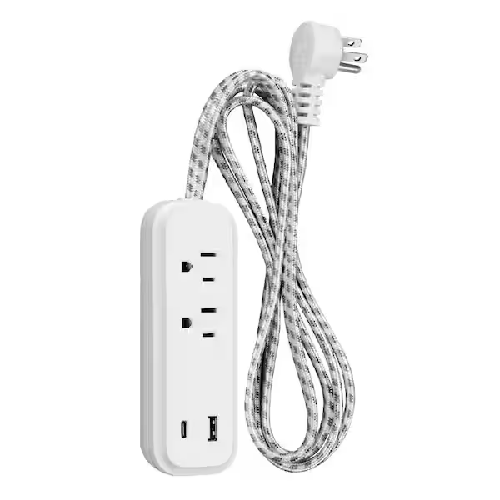
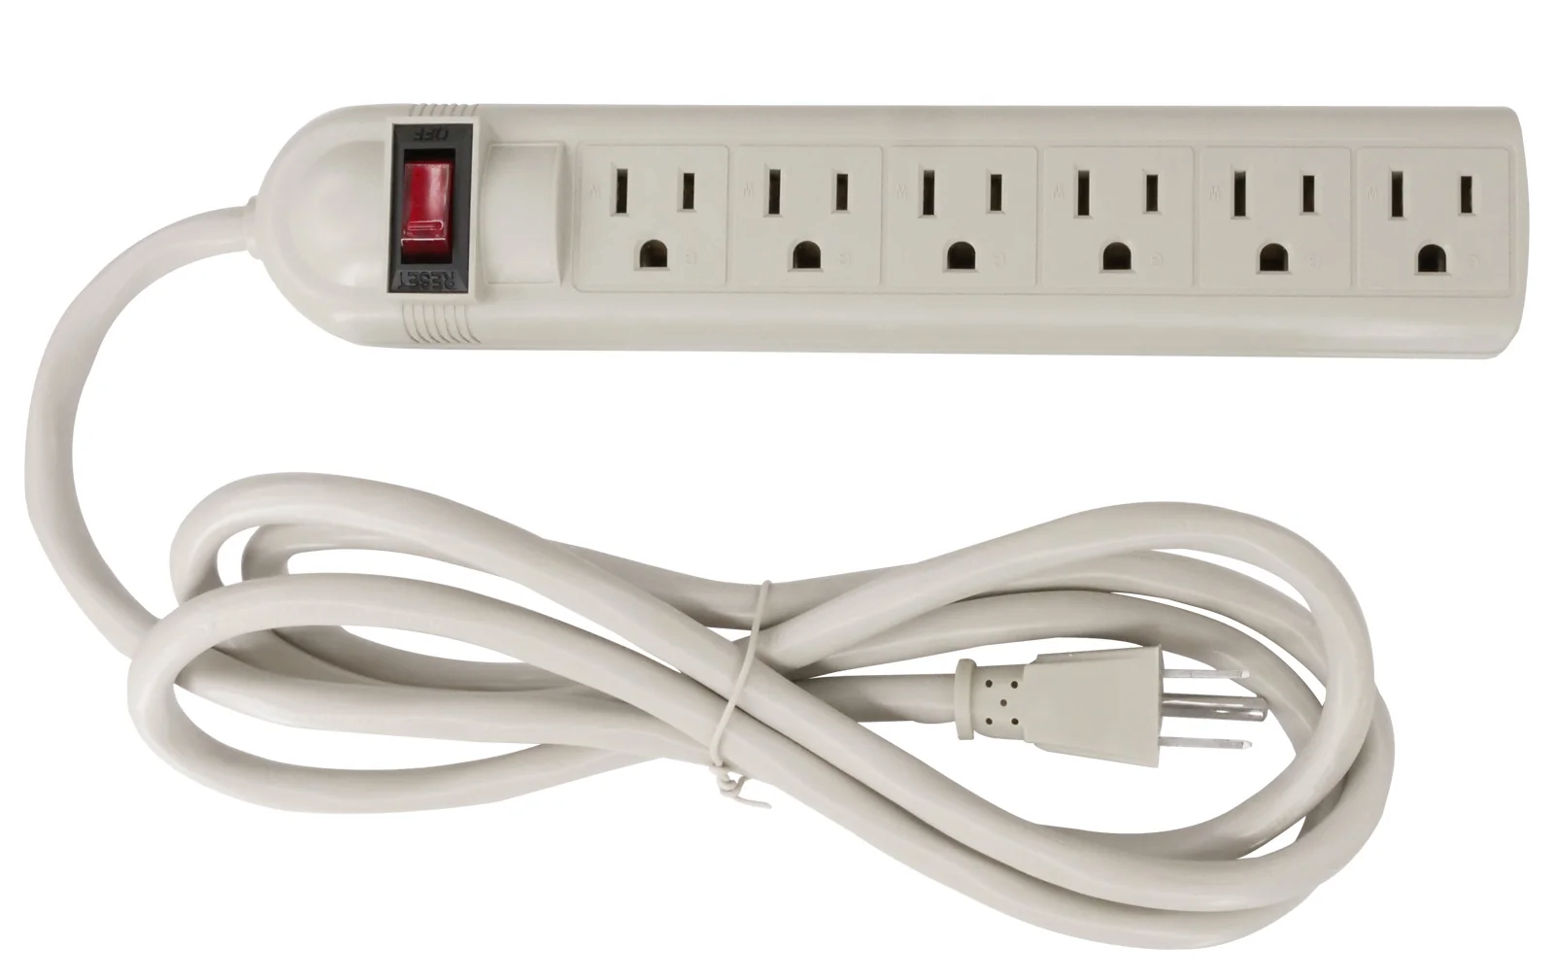
PC: Always use a surge protector!
Will prevent your hardware from being cooked in a power surge:
RIP 💀:
💯
Hot Tip:
You can also use an uninterruptable power supply (UPS) – basically a backup battery that can keep your computer powered for some time (e.g., 20 mins) if your power goes out.

Slide 22
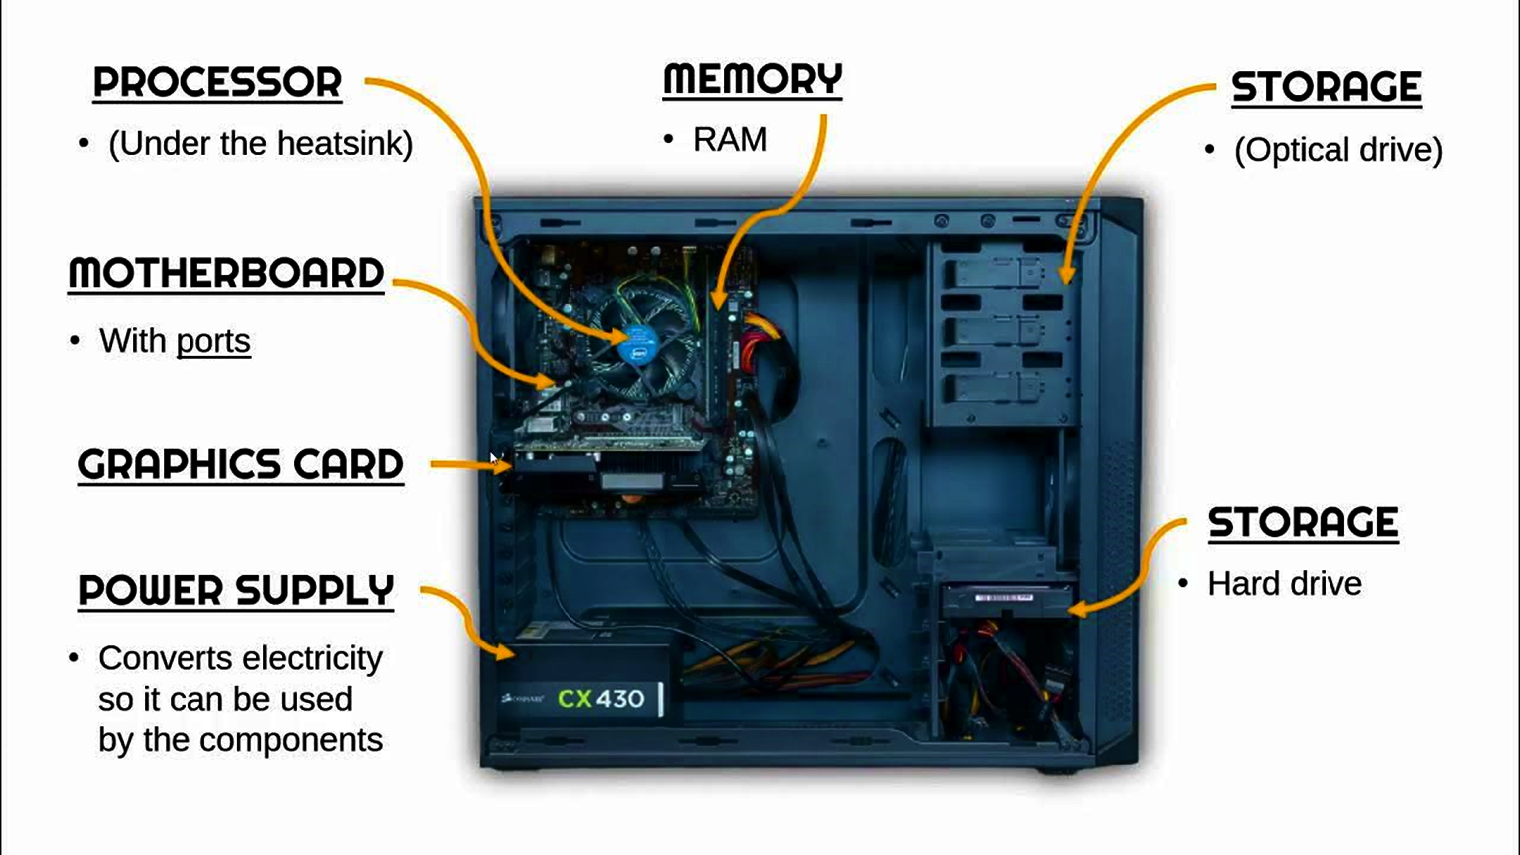
Putting it together
Above: Image from MrBrownCS. Key Internal Computer Parts. YouTube.

Slide 23
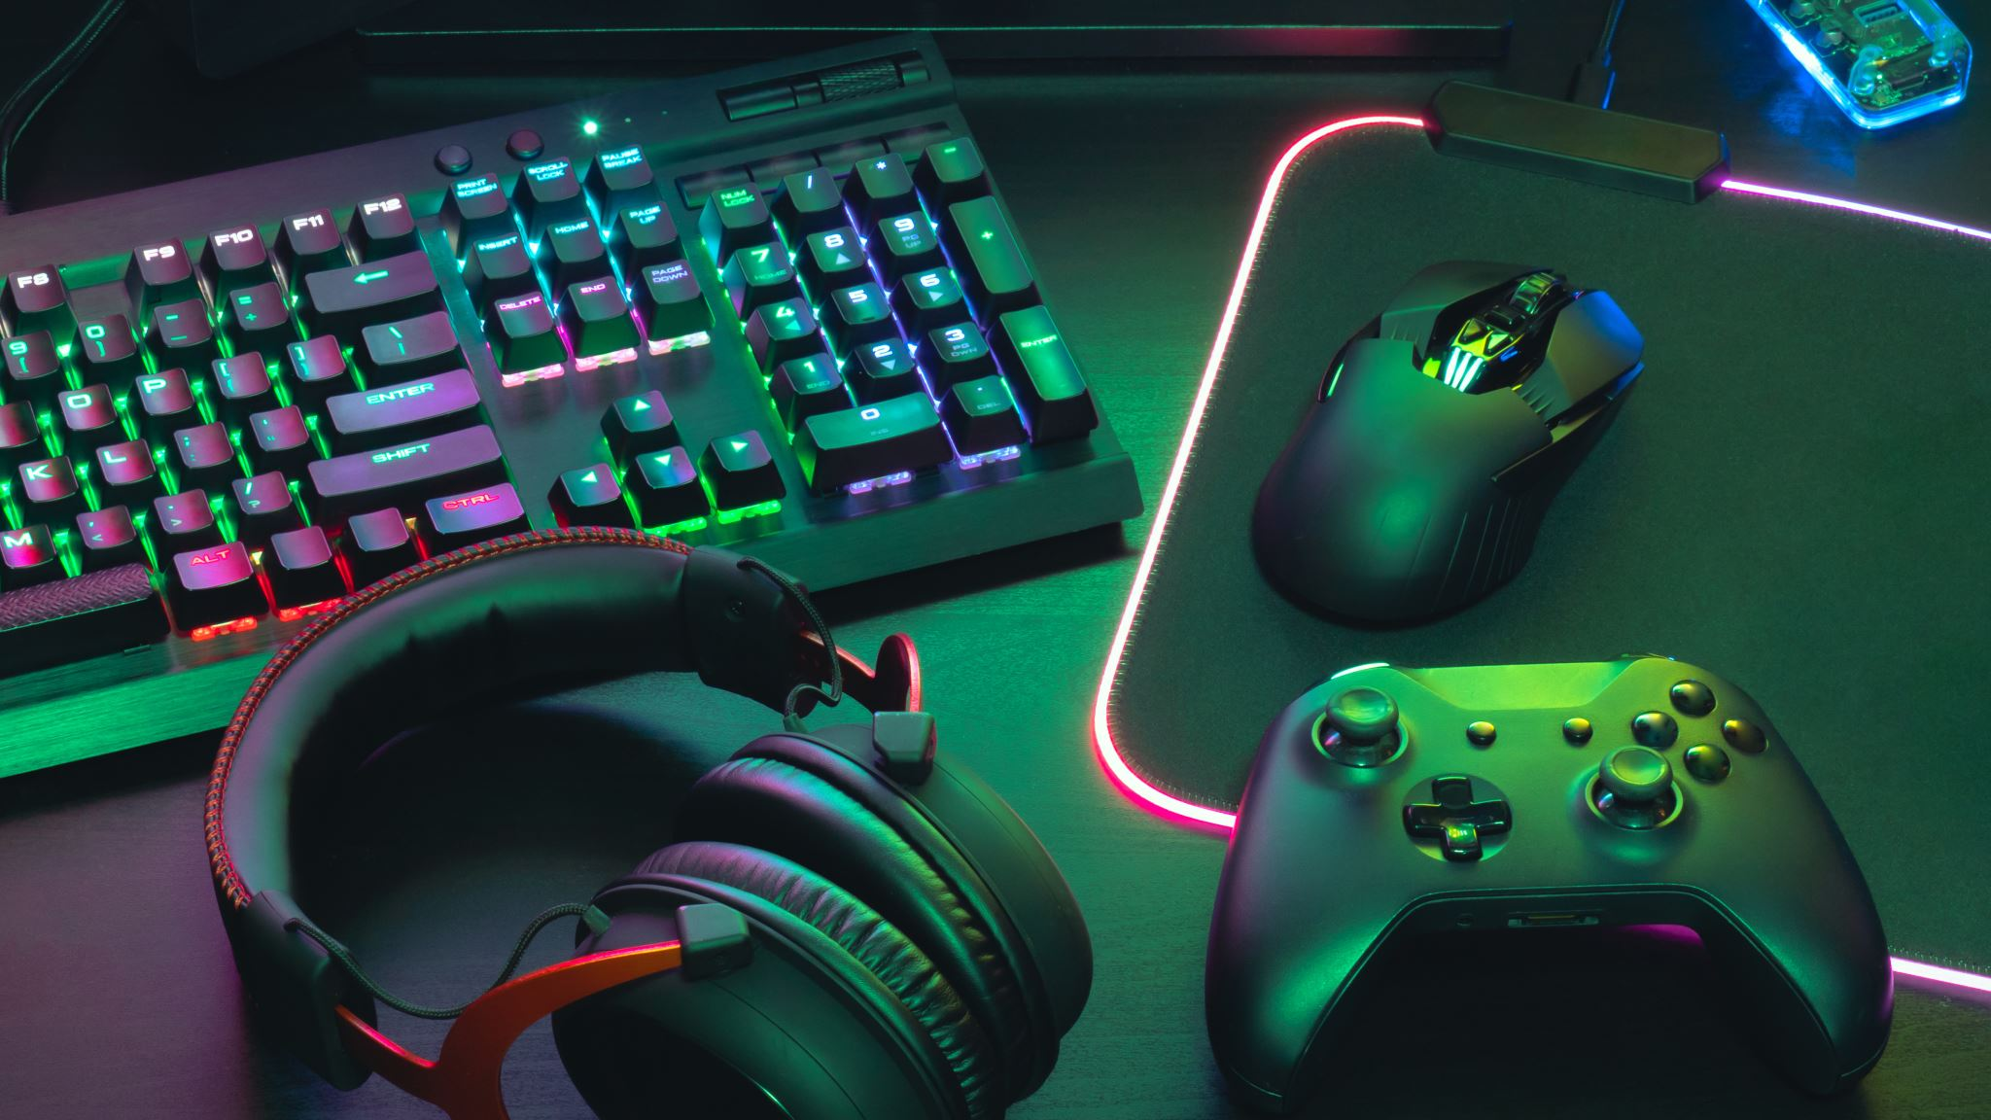
Peripherals and Connections

Slide 24






What is a peripheral device?
KEYBOARD
MOUSE
CONTROLLER
MONITOR
HEADPHONES
FLASH DRIVE

Slide 25
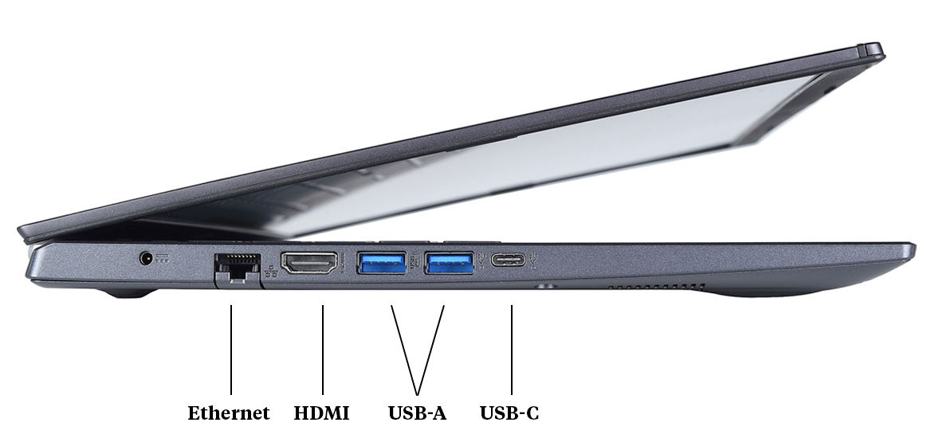
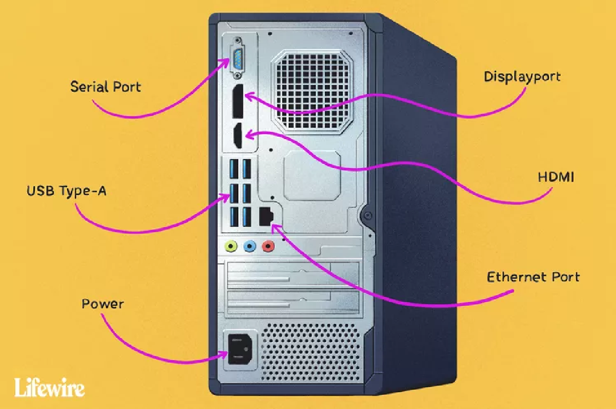
Ports on a computer: Desktop vs. Laptop
Although the laptop above features an Ethernet (RJ-45) port, it is hard to find a laptop in 2025 that still has one! For one, it makes your laptop’s form factor thicker. (You can buy USB adapters though!)
Consider what ports you might need for all your peripherals before you purchase!
Enterprise desktops tend to include DisplayPort ports for several reasons (locking, support multiple monitors, higher bandwidth than HDMI ➔ better resolutions & refresh rates).

Slide 26

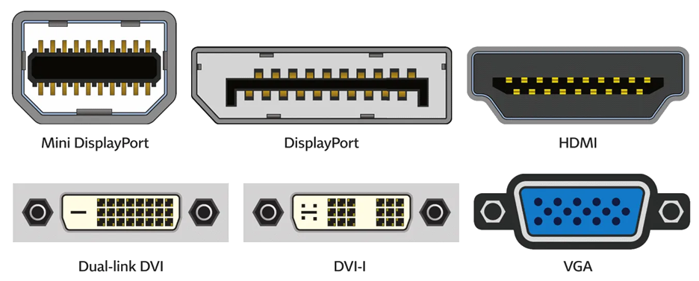
Display Connector Cables
HDMI – Most commonly used for monitors and TVs.
DisplayPort – Used in professional settings and for gaming monitors. Superior to HDMI!
VGA and DVI – older screw-in cables found on CRT monitors and some older LED and LCD monitors.
Notes:
HDMI has many different versions with the same connector, double check that you are using the correct version for your needs.
DisplayPort allows to chained connections.
Both DVI connections are digital while older VGA is an analog connection.

Slide 27
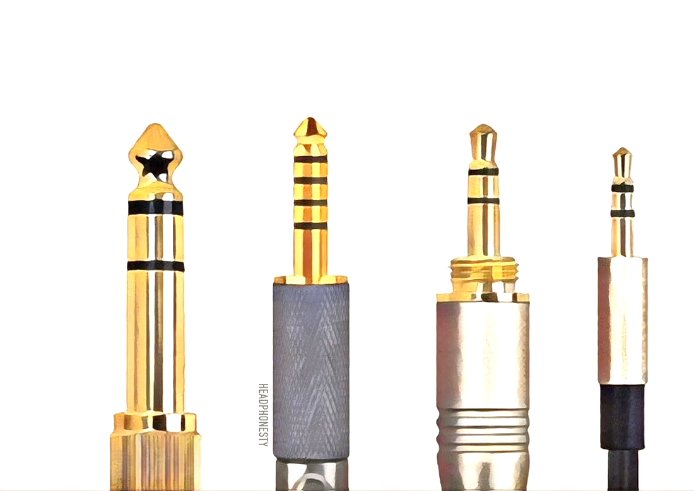
Audio
Most audio is processed “on-board” – either by the motherboard or the GPU.
Sound Cards, like GPUs, do exist – mostly used in studio settings.
USB connections, HDMI and DisplayPort also serve as an audio connection, along with the “Headphone Jack” TRS connector of various sizes.
Notes:
The largest metal sleeve at the bottom is most commonly used for the “neutral” wire in an electric circuit. The tip is most often used as the “hot” wire. Any other “rings” in the jack connect to other hot connections that are used to send multiple signals within the same cable- most often stereo sound.

Slide 28
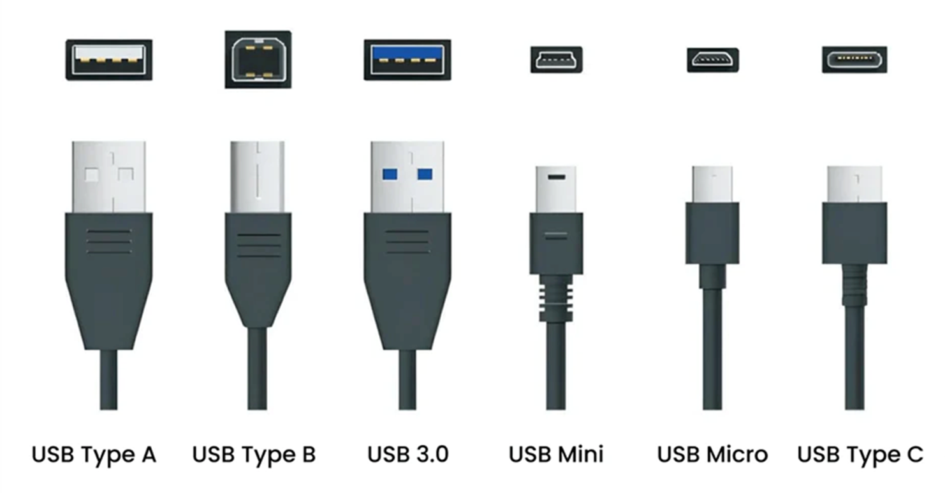

USB Connector Cables (Power and/or data)
Honorable Mention:
Lightning Cable

Slide 29

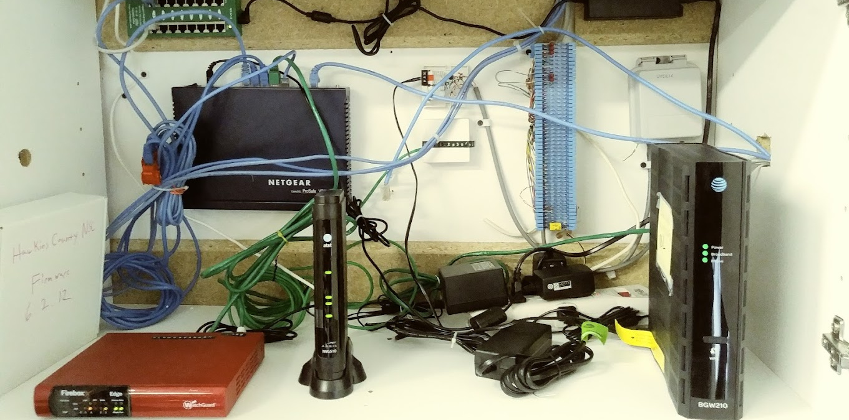
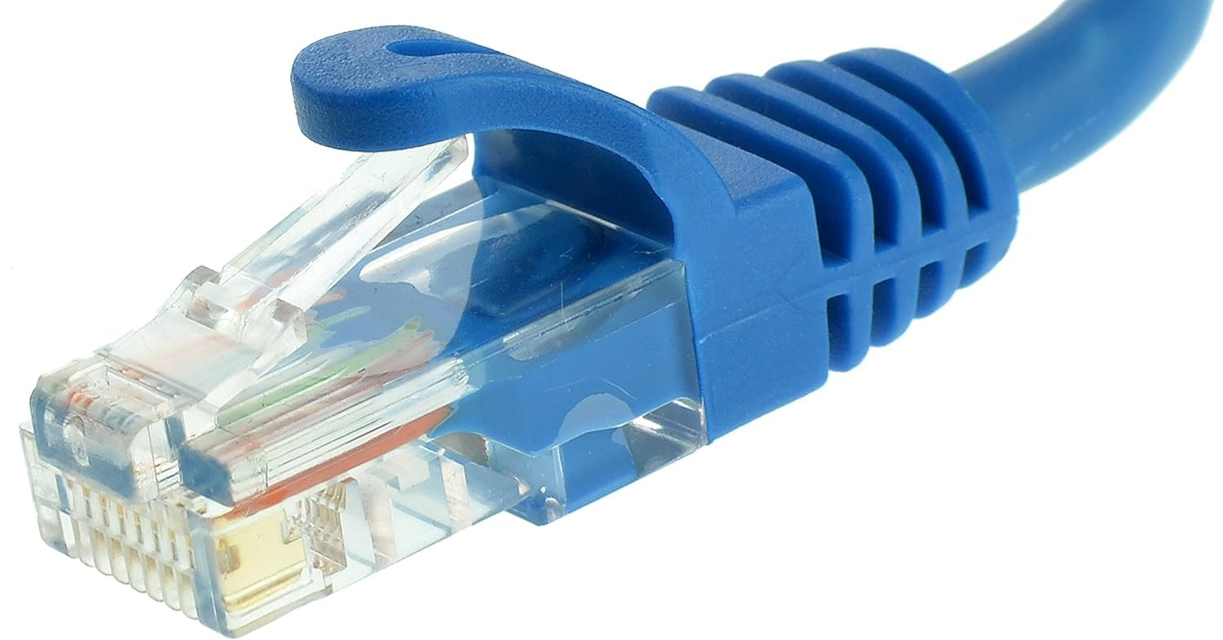
Ethernet Cable (RJ-45)
Primarily used for computer networking
Allows multiple computers to communicate

Slide 30

Discussion: What should I buy?
In the following scenarios, think about your needs for processing power, multitasking, storage space, and portability:
Basic Tasks (Homework, Netflix, Chatting)
Gaming (Console v.s. Mobile v.s. PC – what fits your needs? Why?)
Professional Use (Studio Recording, Video Editing, Art)

